Slide 1
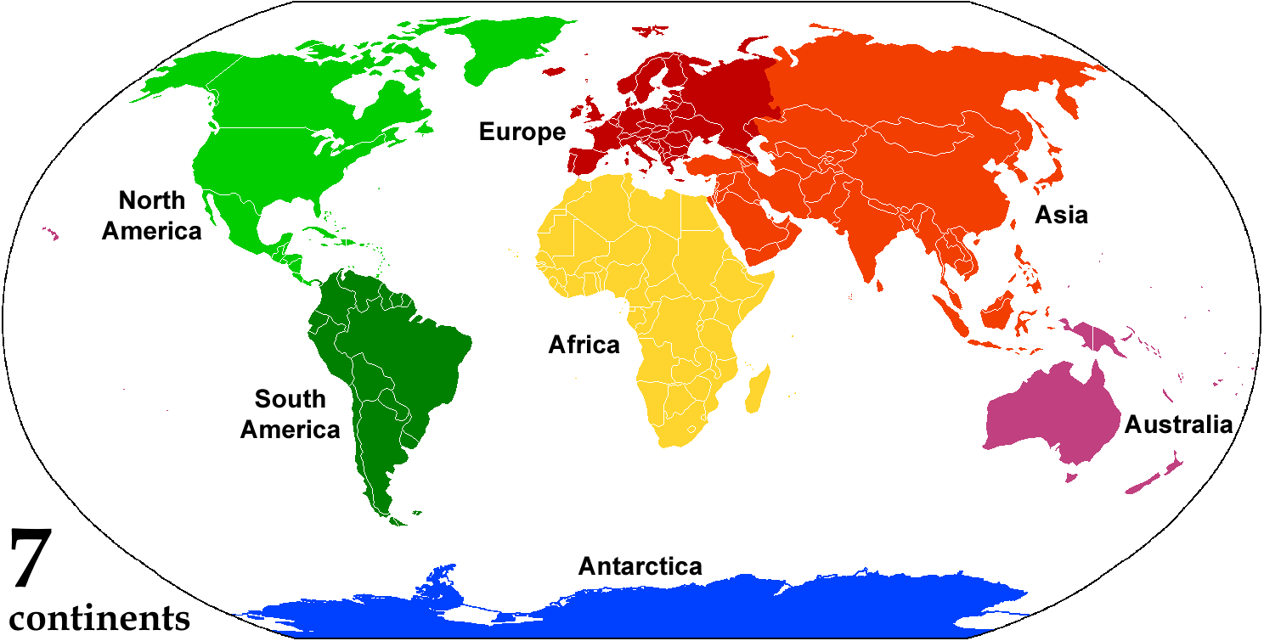
ENGLISH-SPEAKING COUNTRIES
pptcloud.ru

Slide 2
The largest country is Russia. The smallest country is the Vatican.

Slide 3
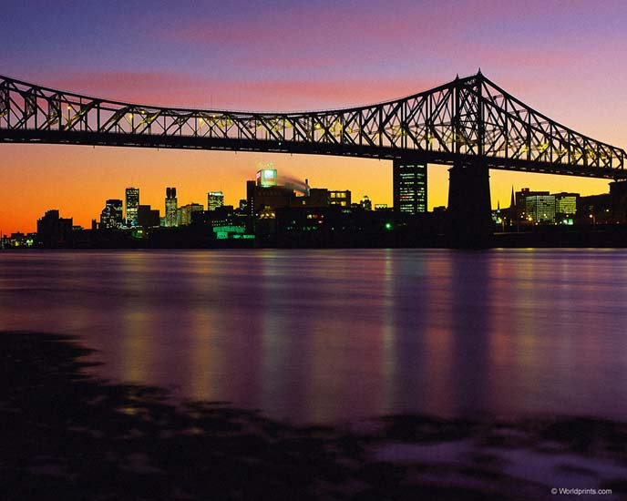
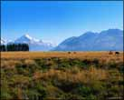
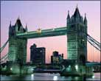
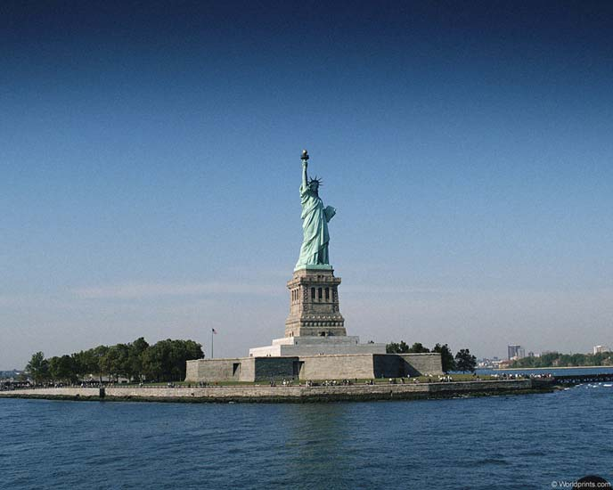
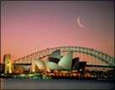
English is the native language in:

Slide 4
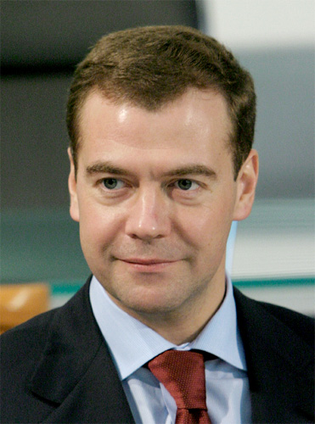
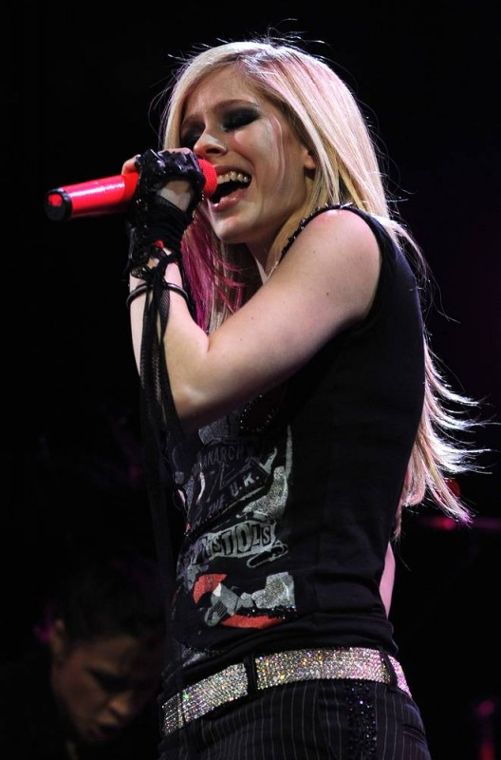
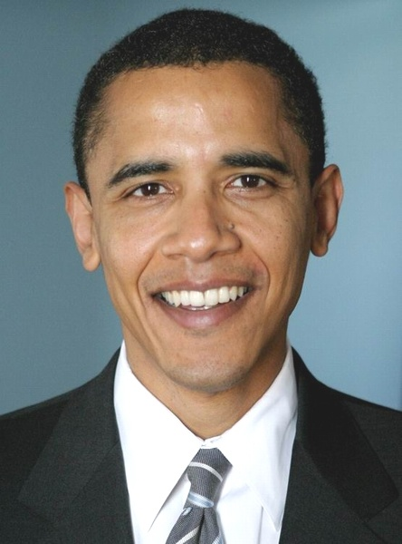
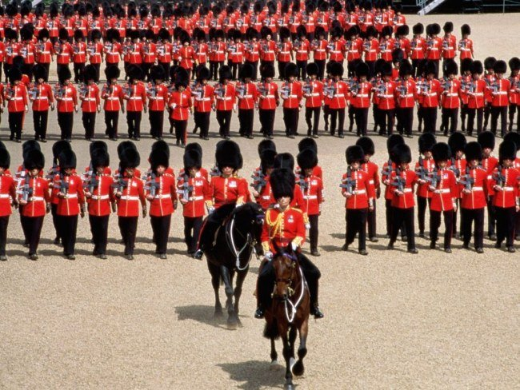

Slide 5
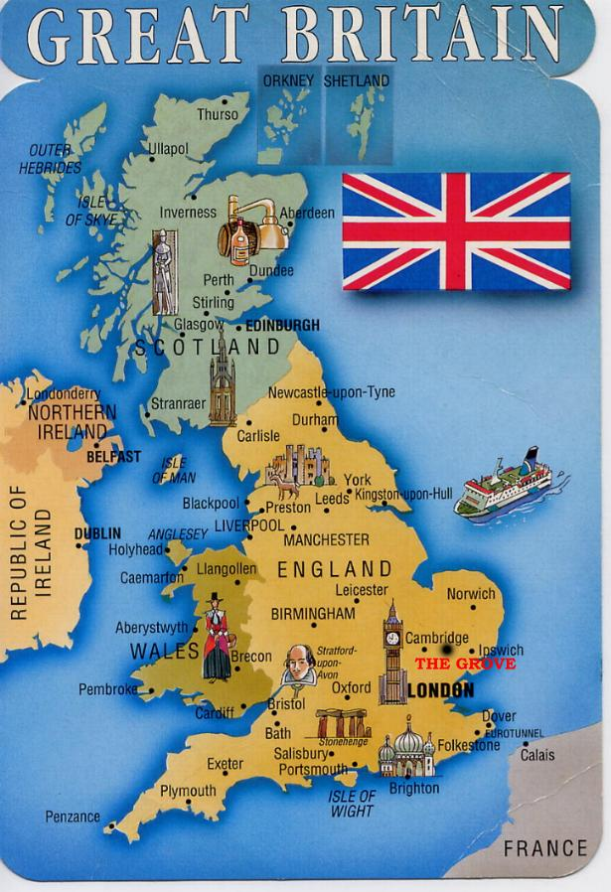
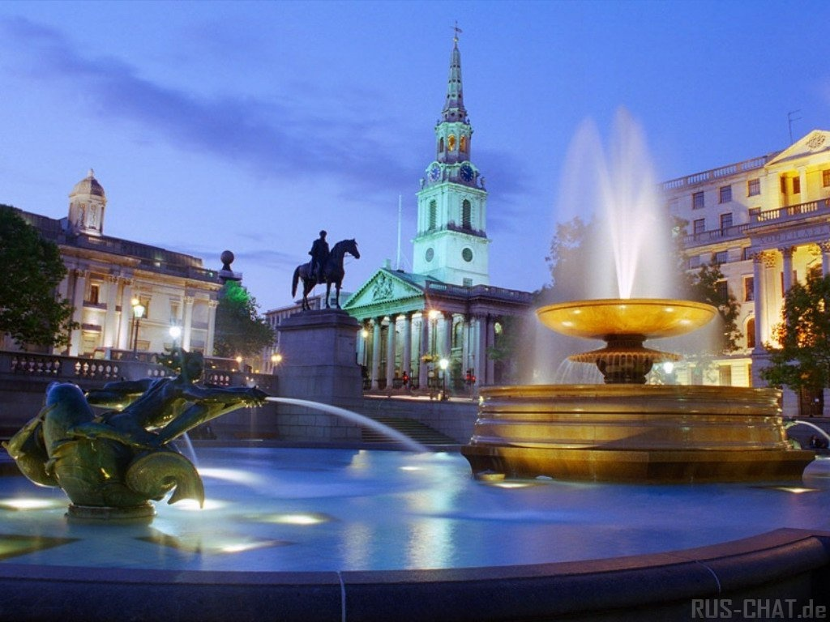
The United Kingdom of Great Britain and Northern Ireland
The capital of Great Britain is London.
People – the British

Slide 6
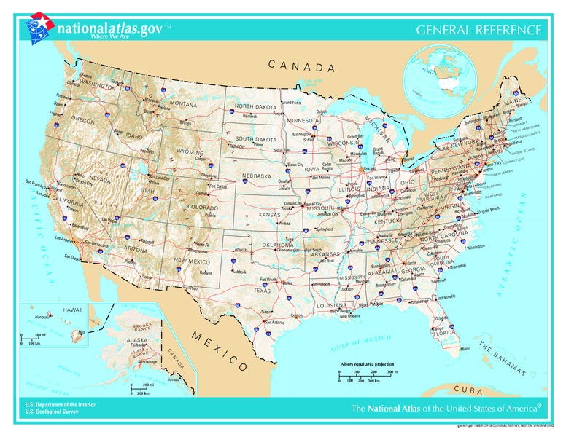
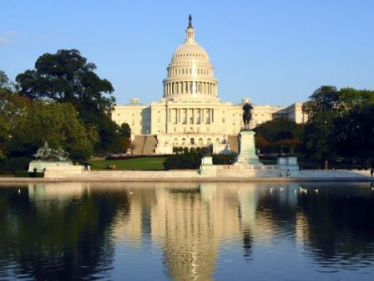
The United States of America
The capital of America is Washington.
People –
the Americans

Slide 7
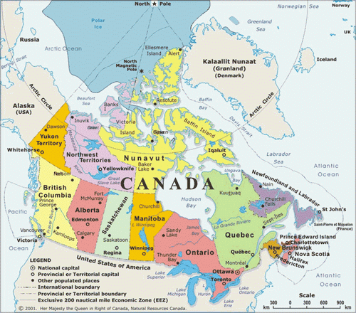
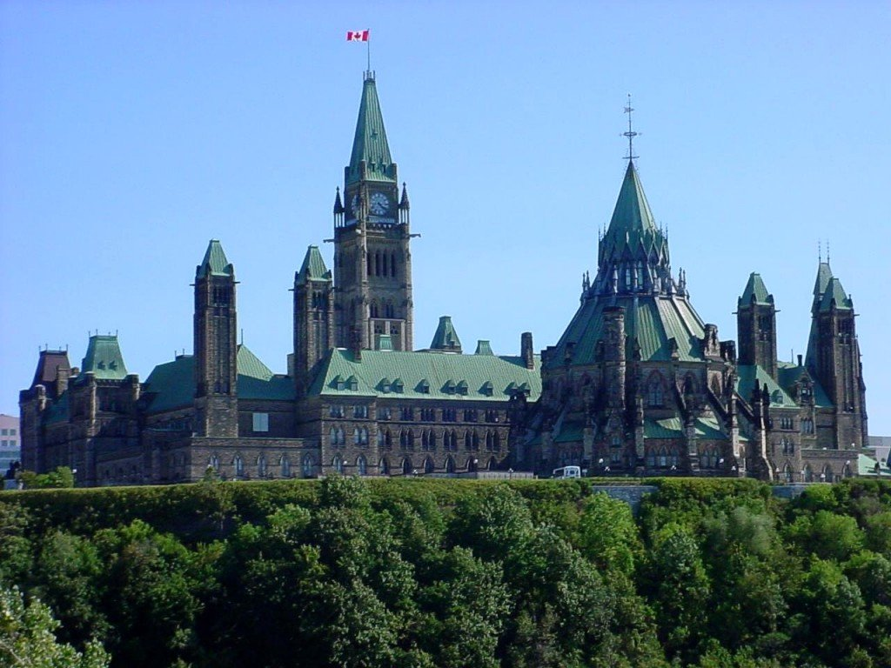
Canada
The capital of Canada is Ottawa
People –
the Canadians

Slide 8
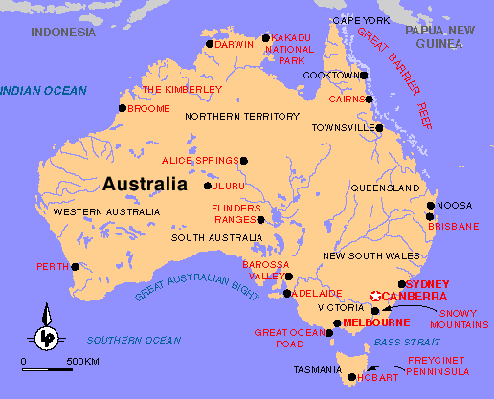
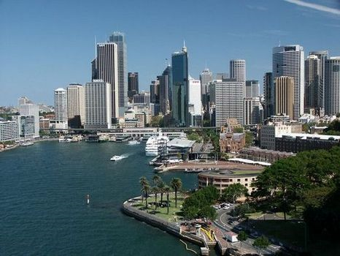
Australia
The capital of Australia is Canberra.
People –
the Australians

Slide 9
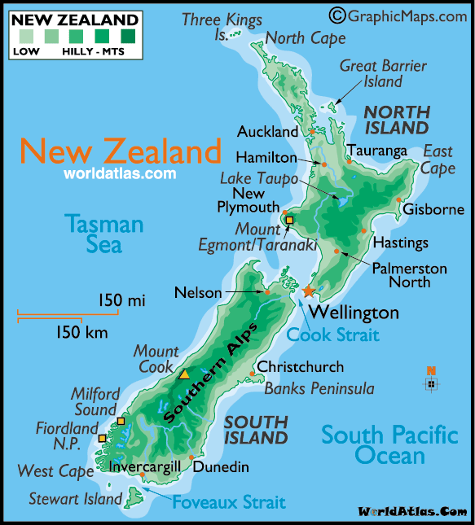
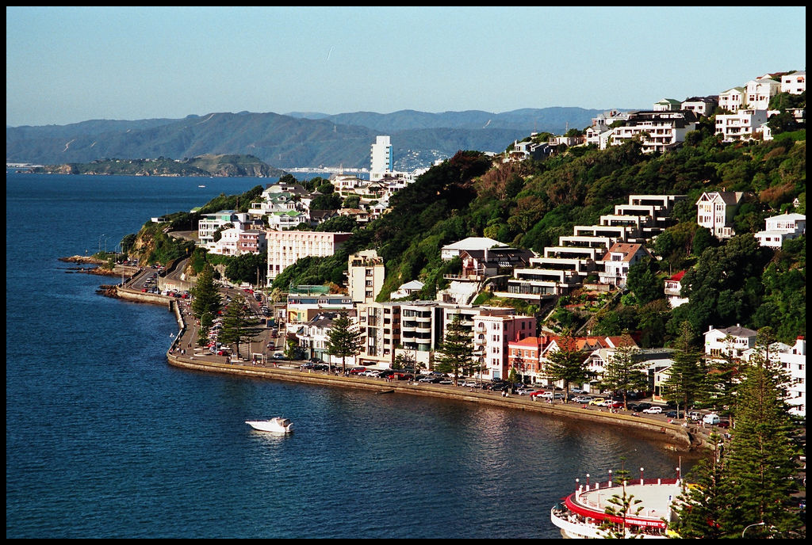
New Zealand
The capital of New Zealand is Wellington.
People –
the New Zealanders

Slide 10
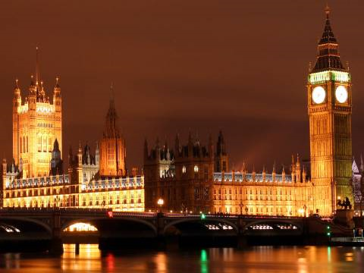
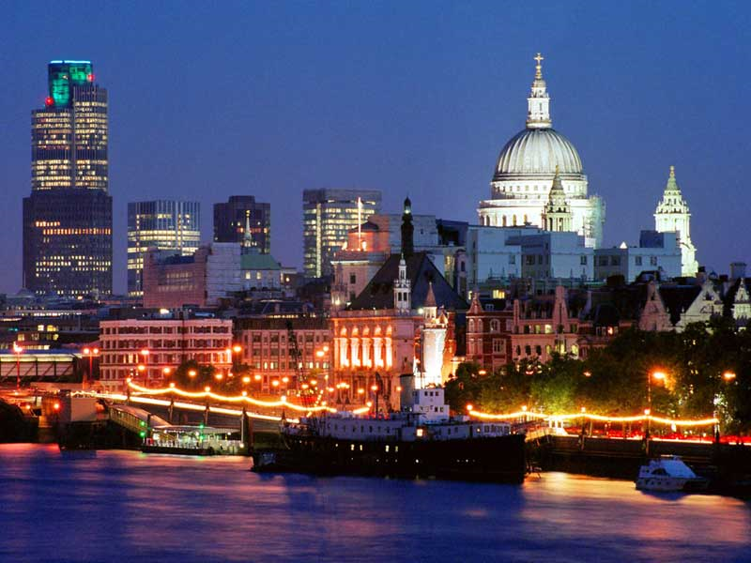
Welcome to Great Britain
London is the capital of
Great Britain.
It stands on the river Thames.
It is very old city .
It is two thousand years old.
Now London is a big port and a beautiful city.
About seven million people live here.

Slide 11
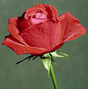
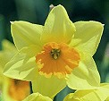
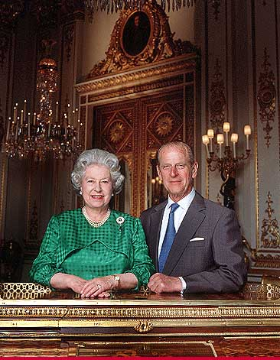
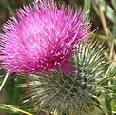
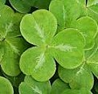
British symbols The Queen of Great Britain is Elizabeth II. Her husband is Duke of Edinburgh.
The rose is the national emblem of England.
The national flower of Scotland is the thistle.
The national flower of Wales is the daffodil.
The national flower of Northern Ireland is the shamrock.

Slide 12
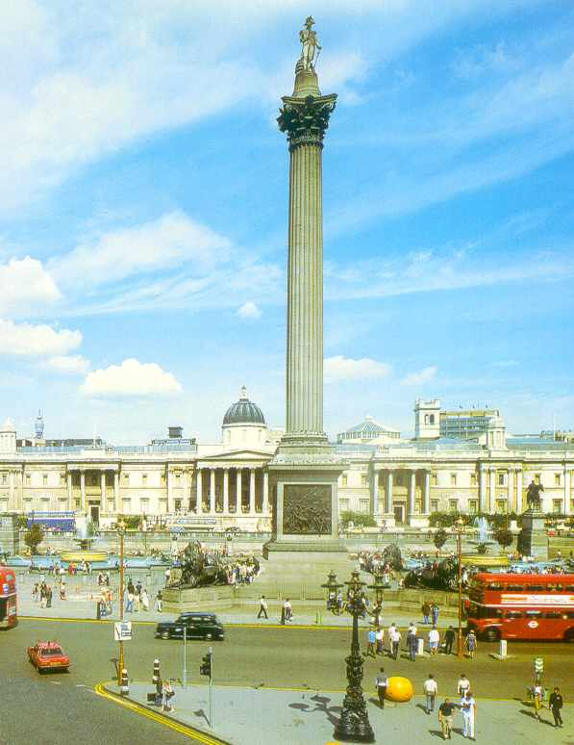
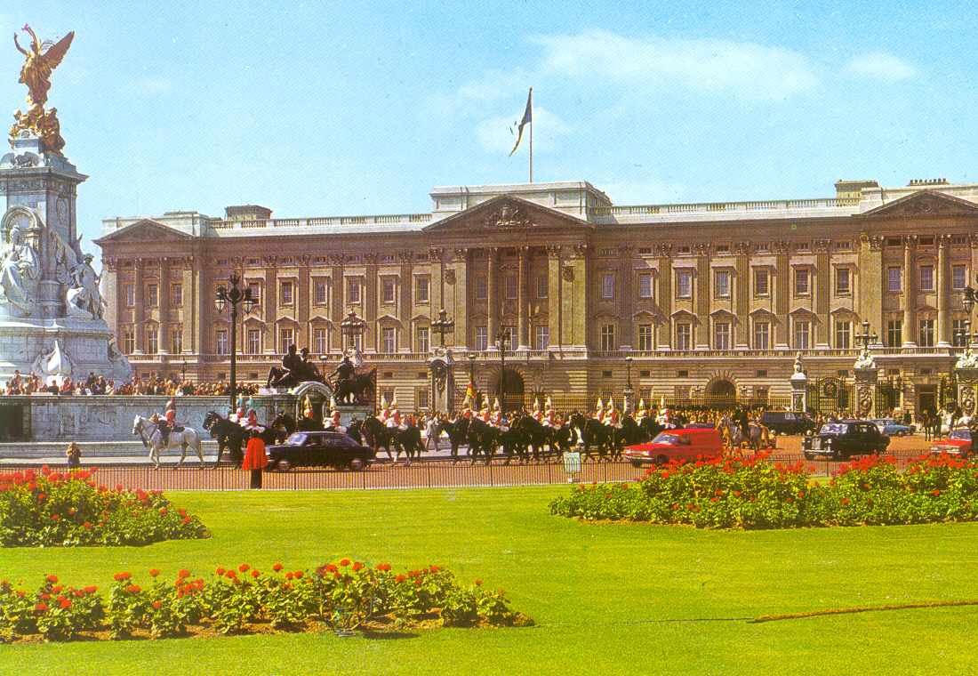
Trafalgar Square Buckingham Palace In the middle of the square This is the Queen’s home. there is Admiral Nelson’s Column.

Slide 13
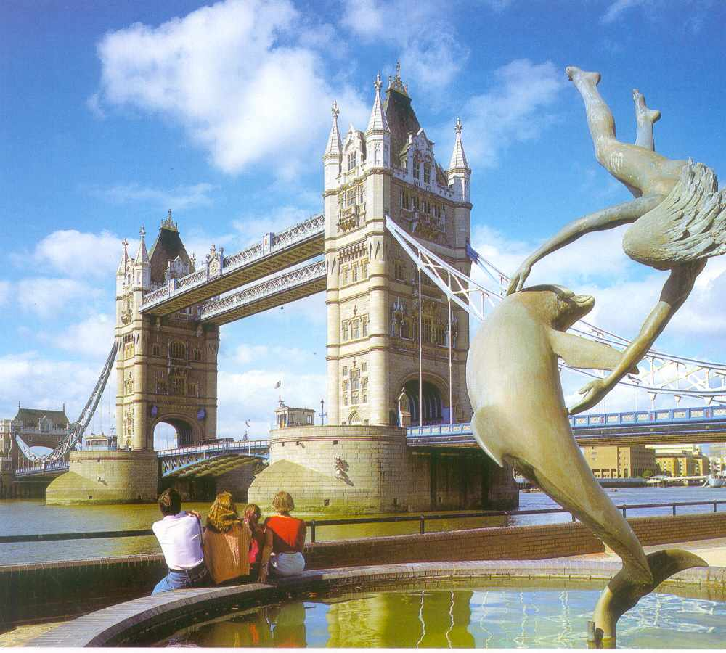
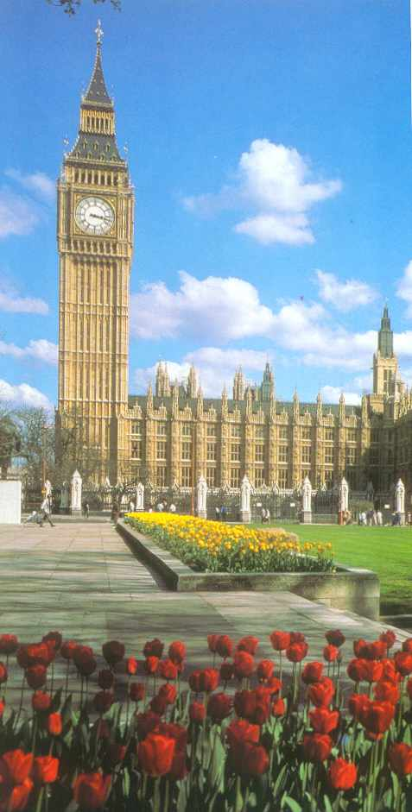
Tower Bridge - Big Ben- the most famous bridge in London the big clock tower

Slide 14
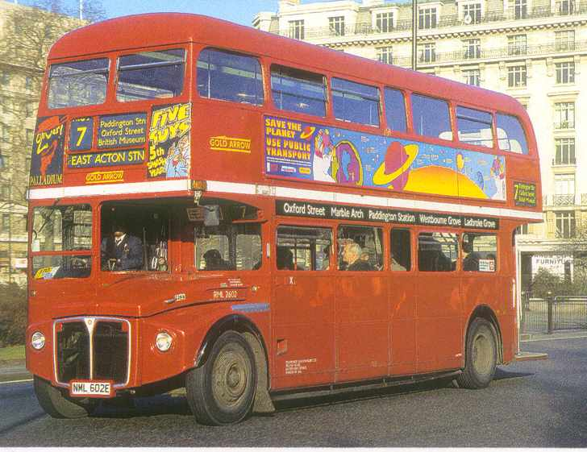
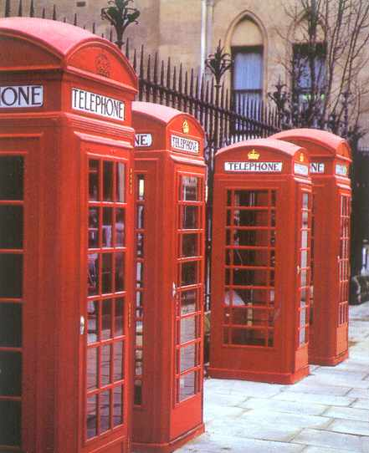
Double-deckers Telephone booths There are big red buses called From here you can call your friends. double-deckers in London.

Slide 15
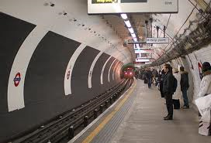
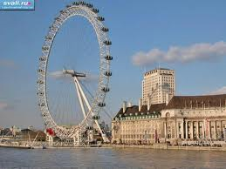
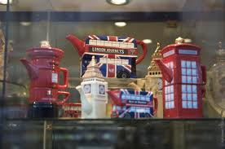
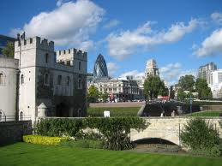
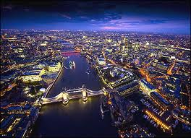
ENJOY SIGHTSEEINGS of LONDON !!!

Slide 16
Revision
What English-speaking countries do you know?
Answer: They are … , … , … , … , … .
What are their capitals?
Answer: …… is the capital of ……. .
What floral symbols of the UK do you know?
Answer: They are … , … , … , … .
How is a big red bus called in London?
Answer: It is called … .
How can you call your friends in London?
Answer: We can call from … .

