Slide 1
Travel around the UK

Slide 2
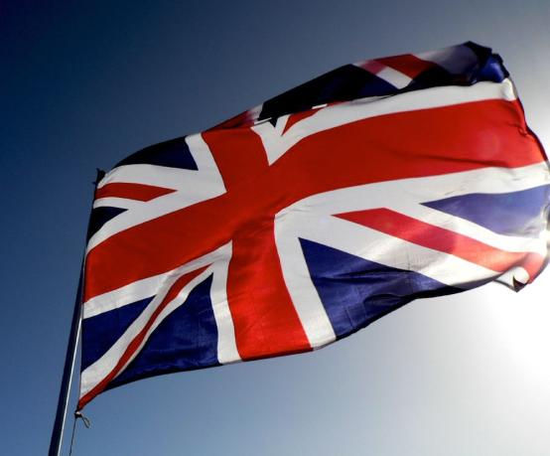
UNITED KINGDOM OF GREAT BRITAIN AND NORTHERN IRELAND
The national flag of Great Britain is…

Slide 3
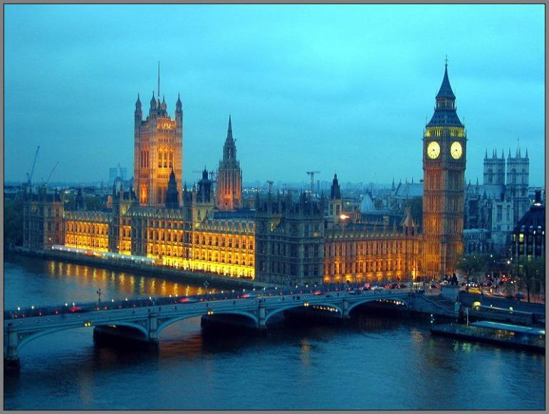
The British capital is London

Slide 4
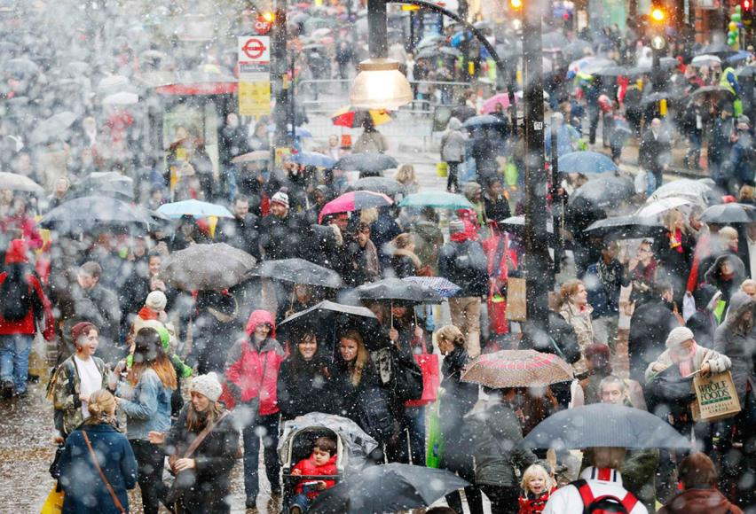
The population of the UK is 62 million people.

Slide 5
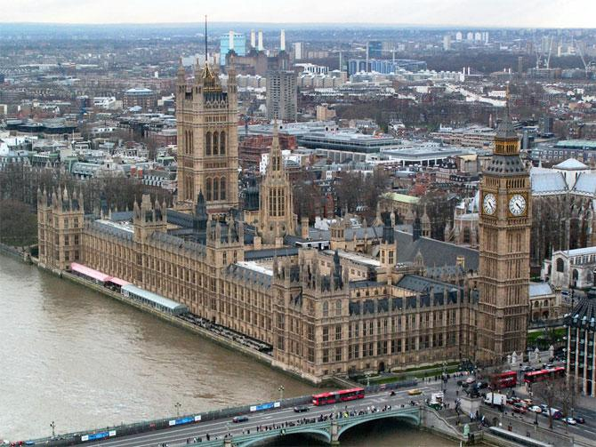
The total area of the UK is 244 017 sq km

Slide 6
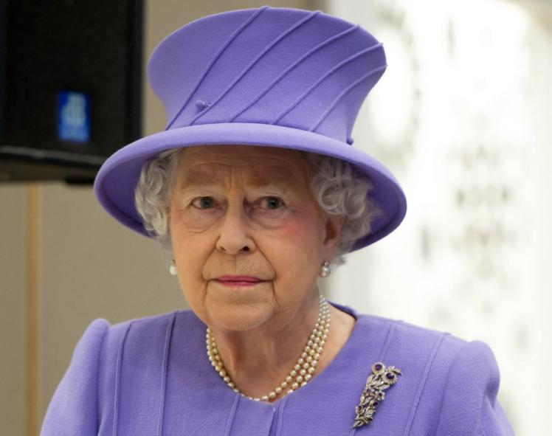
The Queen of England is Elizabeth II

Slide 7
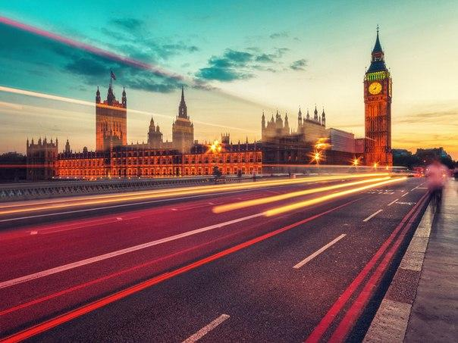
The United Kingdom of Great Britain and Northern Ireland is situated on the British Isles. The British Isles consist of two large islands, Great Britain and Ireland, and above five thousand small islands. Their total area is over 244 000 square kilometers. The United Kingdom is made up of four countries: England, Scotland, Wales and Northern Ireland. Their capitals are London, Edinburgh, Cardiff and Belfast respectively.

Slide 8
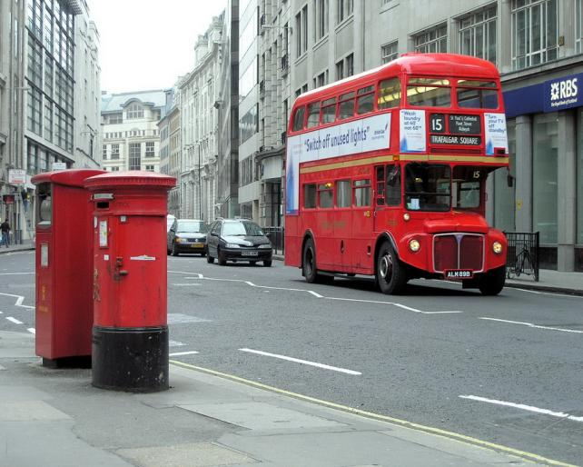
One of the most visited cities is London. This city is the capital of the UK. It's a huge metropolis, the area of this city is 1706,8 km. More than eight million people live there. Date of creation of London is 43.

Slide 9
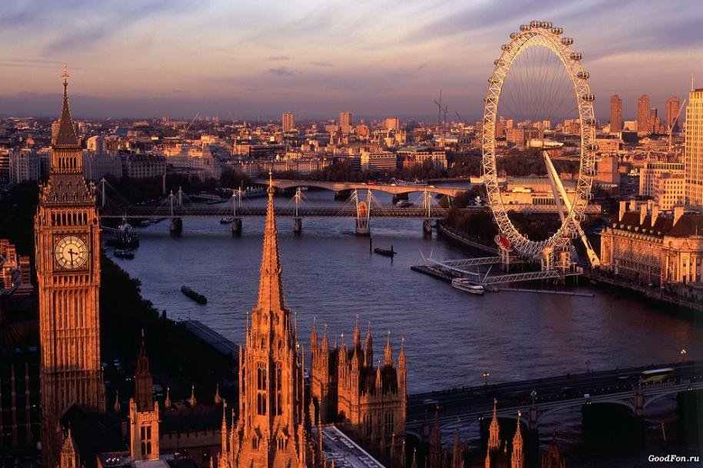
English and Welsh are the official languages of Britain.

Slide 10
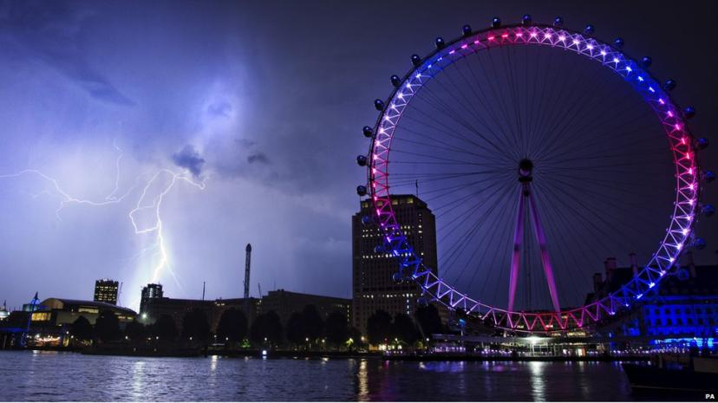
The London Eye
The London Eye is one of the largest Ferris wheels in the world, located in the London borough of Lambeth on the South Bank of the Thames.

Slide 11
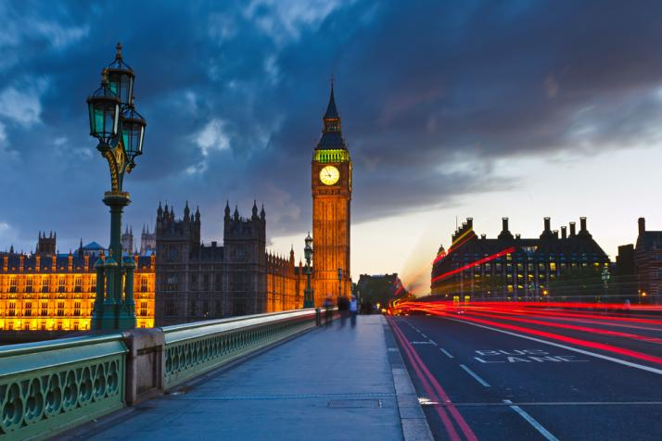
Big Ben
Big Ben is the most famous landmark of London. Although often called "big Ben" refers to the clock tower of the Palace of Westminster, more formally known as "St. Stephen's tower", in fact, big Ben is the largest bell of the six located in the tower.

Slide 12
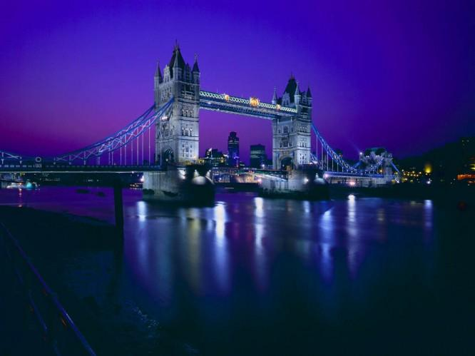
Tower bridge
This bascule bridge. Thousands of tourists come here to look at the bridges. But to arrive just in time is quite difficult, because in the past the bridge was diluted every time the ship needed to pass under it, and now, by prior arrangement only.

Slide 13
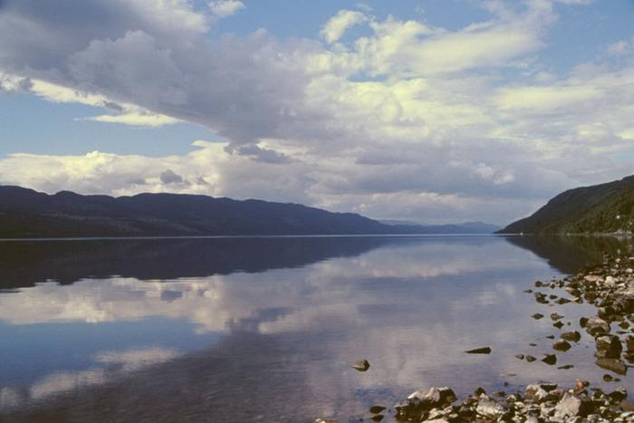
Loch Ness Lake
Loch ness is a lake in Scotland. The length of the lake - 37 miles and a width of 2 kilometers. Its maximum depth reaches 200 meters.

Slide 14
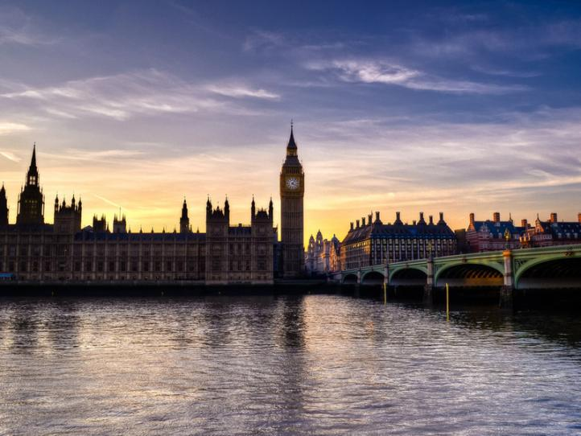
Thank you for your attention!!!

