Slide 1
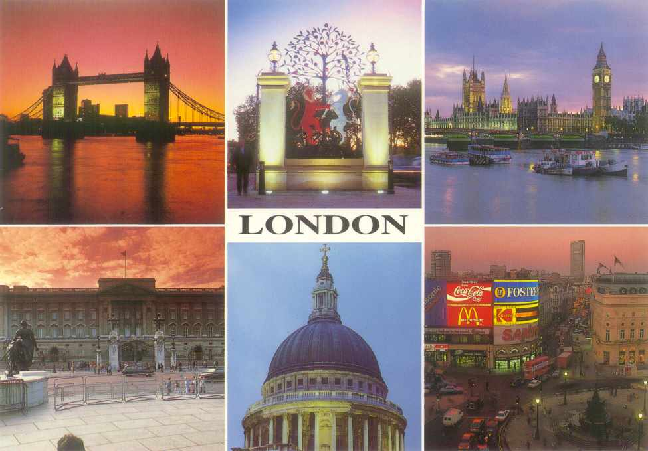
WELCOME TO GREAT BRITAIN!
Sharipova Z

Slide 2
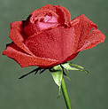
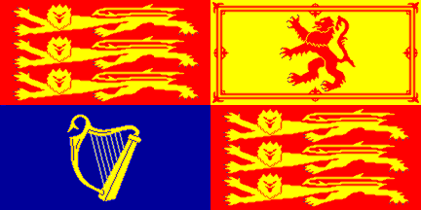
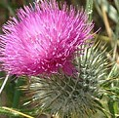
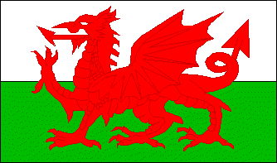
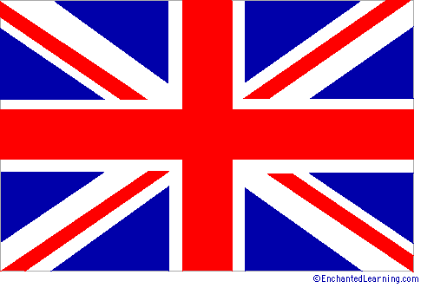
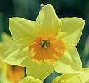
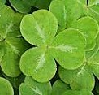

British Symbols

Slide 3
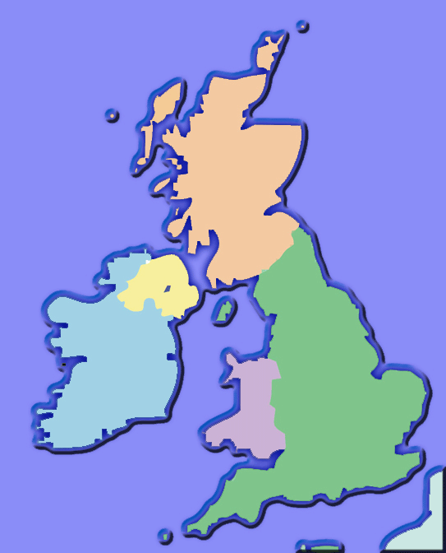
Northern Ireland
Scotland
England
Wales

Slide 4
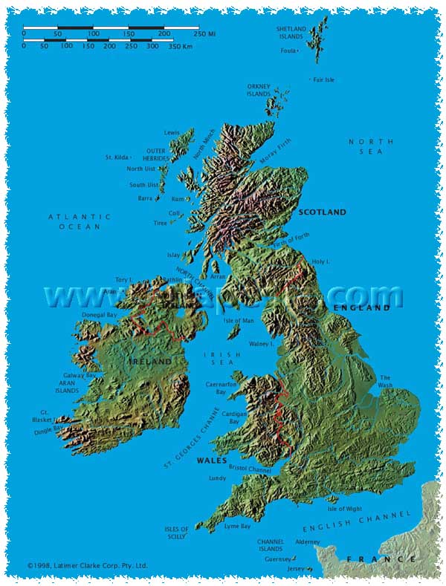
The United Kingdom of Great Britain and Northern Ireland

Slide 5


The national flower of Northern Ireland is the shamrock, a three-leaved plant similar to clover. It is a symbol of trinity
Northern Ireland

Slide 6

The Tudor rose is the national floral emblem of England. It symbolizes the end of the Wars of the Roses.
England

Slide 7

Scotland
The national flower of Scotland is the thistle
Thistle is a prickly-leaved purple flower which was first used in the 15th century as a symbol of defence. The thistle has been a Scottish symbol for more than 500 years. It was found on ancient coins and coats of arms.

Slide 8
The national flower of Wales is the daffodil, which is traditionally worn on St. David’s Day.
Wales

Slide 9
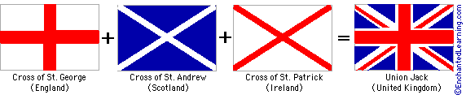
The flag of the UK is a combination of the flags of England (the cross of St. George), Scotland (the cross of St. Andrew), and Ireland (the cross of St. Patrick).

Slide 10
The flag of Scotland - St Andrew’s Cross
Dating to the 12th century, the historic cross of St. Andrew was first hoisted in 1512. Also known as the Saltire, it is one of the oldest country flags. The Saltire is a flag with a diagonal cross whose arms extend to the corners of the flag

Slide 11
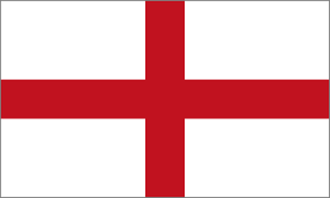
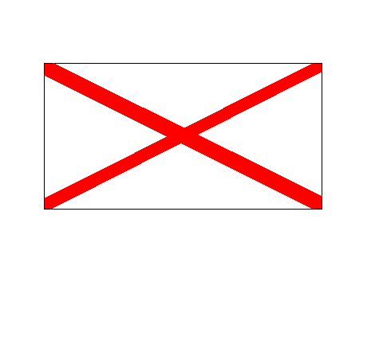
The flag of Ireland - St Patrick Cross
The flag of England - St George’s Cross

Slide 12
Royal Banner of the King or Queen of the United Kingdom Today.

Slide 13
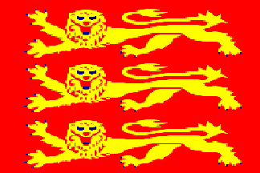
The Royal Banner of England

Slide 14
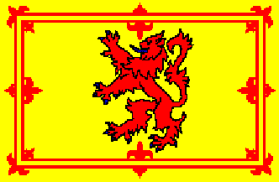
Scottish Royal banner
The Royal Flag of Scotland, or Rampart Lion, features a traditional red lion on a gold field. It is widely used as a second national flag.

Slide 15
The Welsh flag
This flag was officially adopted in 1959, but the red dragon (possibly Roman in origin) has been associated with Wales for many centuries. The green and white background stripes represent the House of Tudor, a Welsh dynasty that once held the English throne.

Slide 16
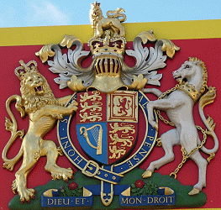
UK Royal Coat-of-Arms

Slide 17
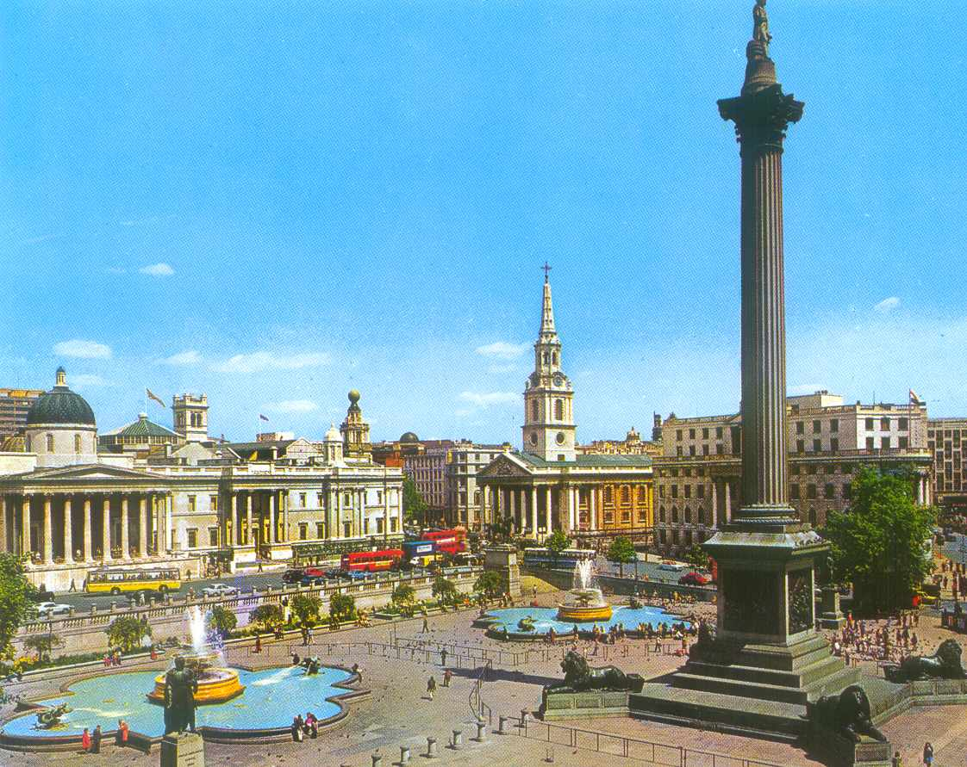
Trafalgar Square

Slide 18
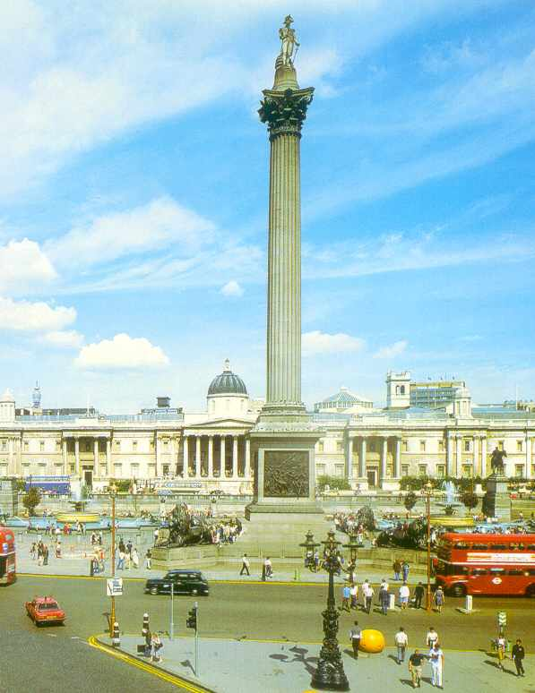
Trafalgar Square
There are always a lot of people and pigeons on the square.
Every winter there is a big Christmas tree which is a gift from Norway in the middle of the square.
On New Year’s Eve people gather around the tree.
In the middle of the square there is Admiral Nelson’s Column.

Slide 19
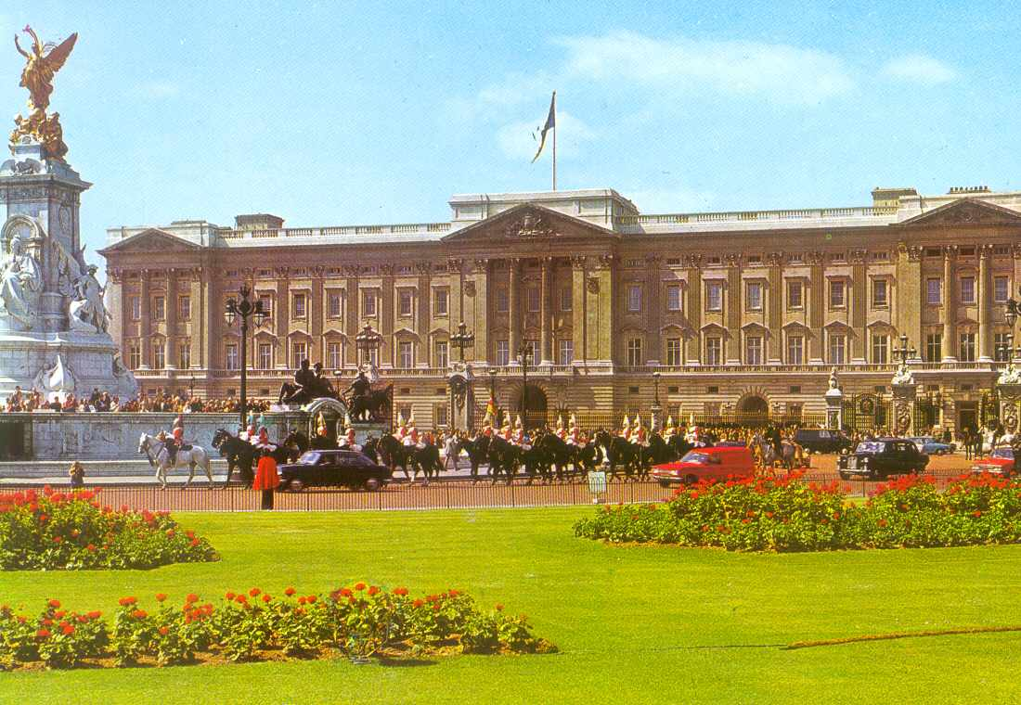
Buckingham Palace
This is the Queen’s home.
It was built in 1703.
There is a great collection of paintings.

Slide 20
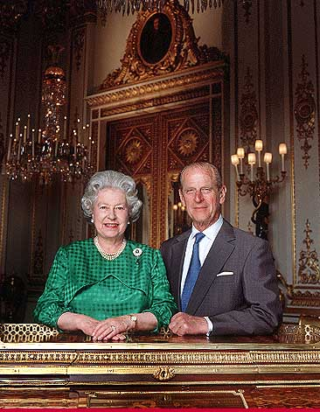
The Queen of Great Britain
The Queen of Great Britain is Elizabeth II. Her husband is Duke of Edinburgh.
They have got 4 grown-up children: Prince Charles, Princess Anne, Prince Andrew and Prince Edward.

Slide 21
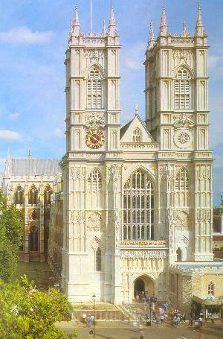
Westminster Abbey
This is a holy place.
All English kings have been crowned and buried in the church since 1308.

Slide 22
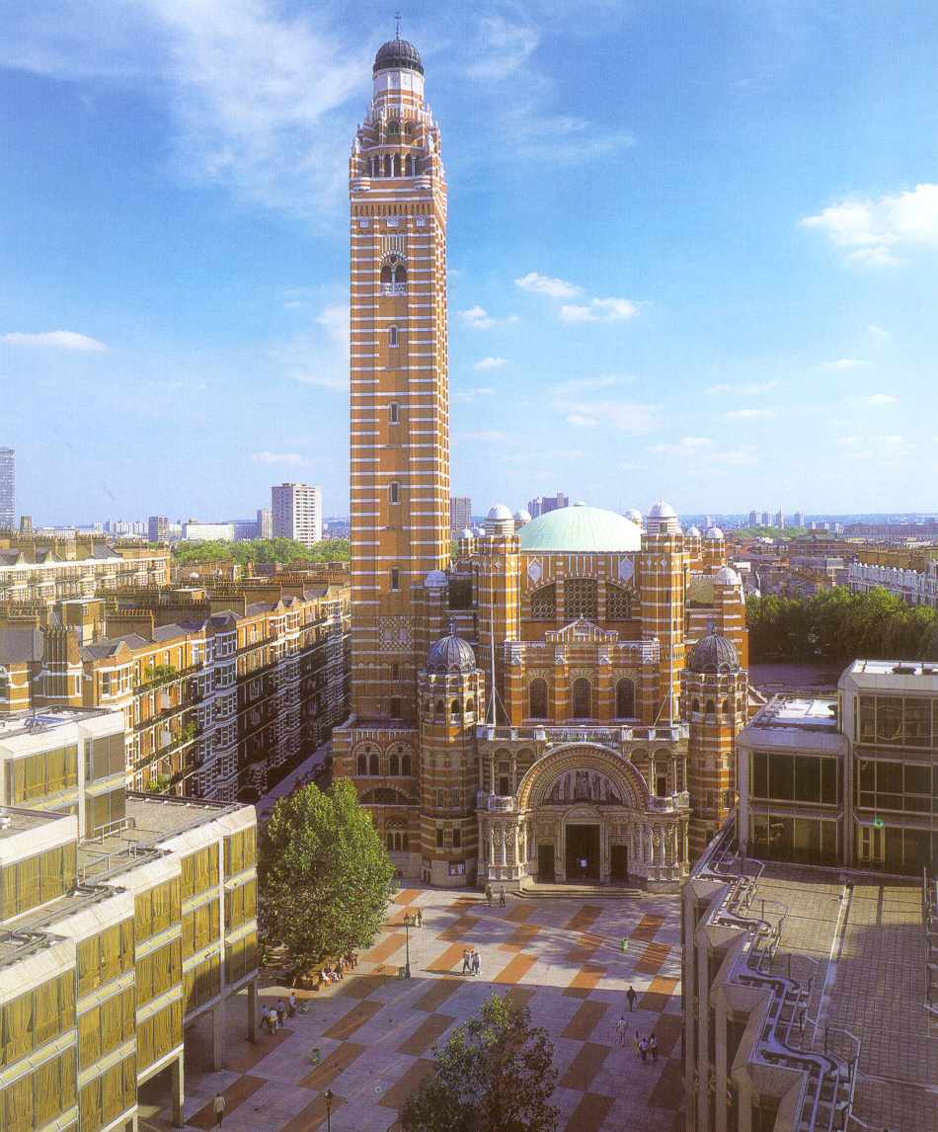
Westminster Cathedral
It was built between 1895 and 1903.
This is the seat of the Cardinal Archbishop and the leading Roman Catholic Church in England.
Its bell tower is 84 metres high.

Slide 23
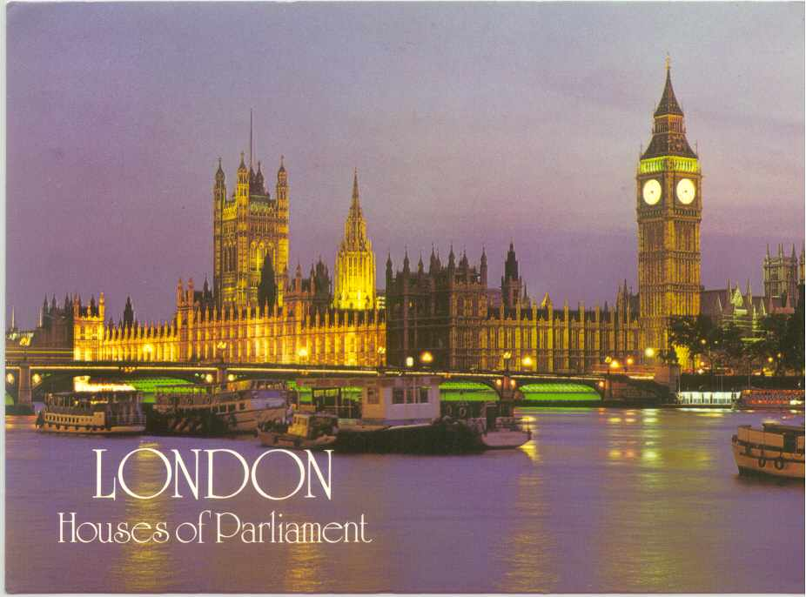
The Houses of Parliament
This big palace is the most famous building in the world – the British Parliament.
The building is 280 metres long.
There are more than 1000 rooms.

Slide 24
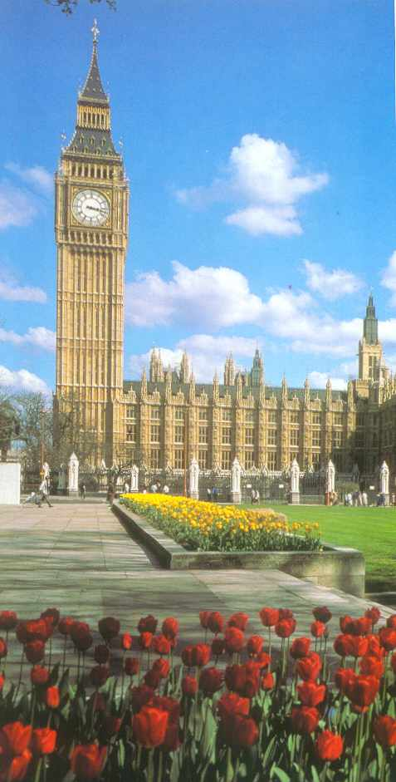
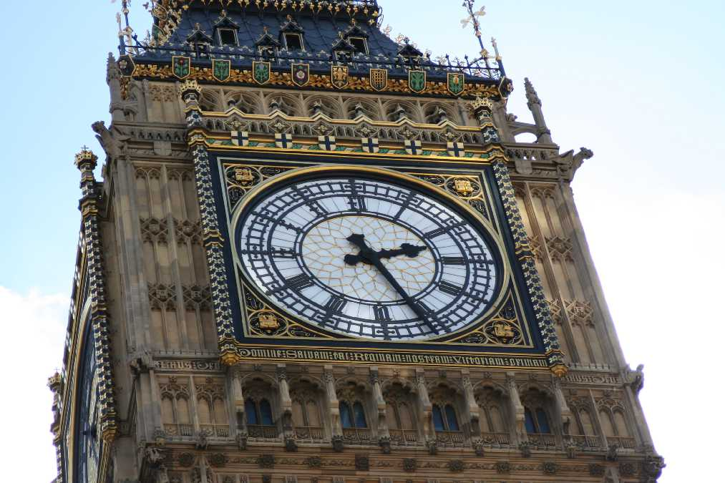
Big Ben
Big Ben, the big clock tower, is the symbol of London. It strikes hours.

Slide 25
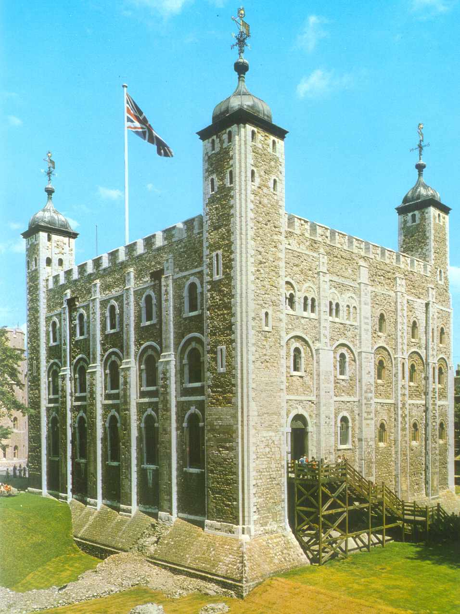
Tower
The Tower of London has been a fortress, a palace, an arsenal, a mint, a prison, an observatory, a zoo, the home of the Crown Jewels and a tourist attraction.

Slide 26
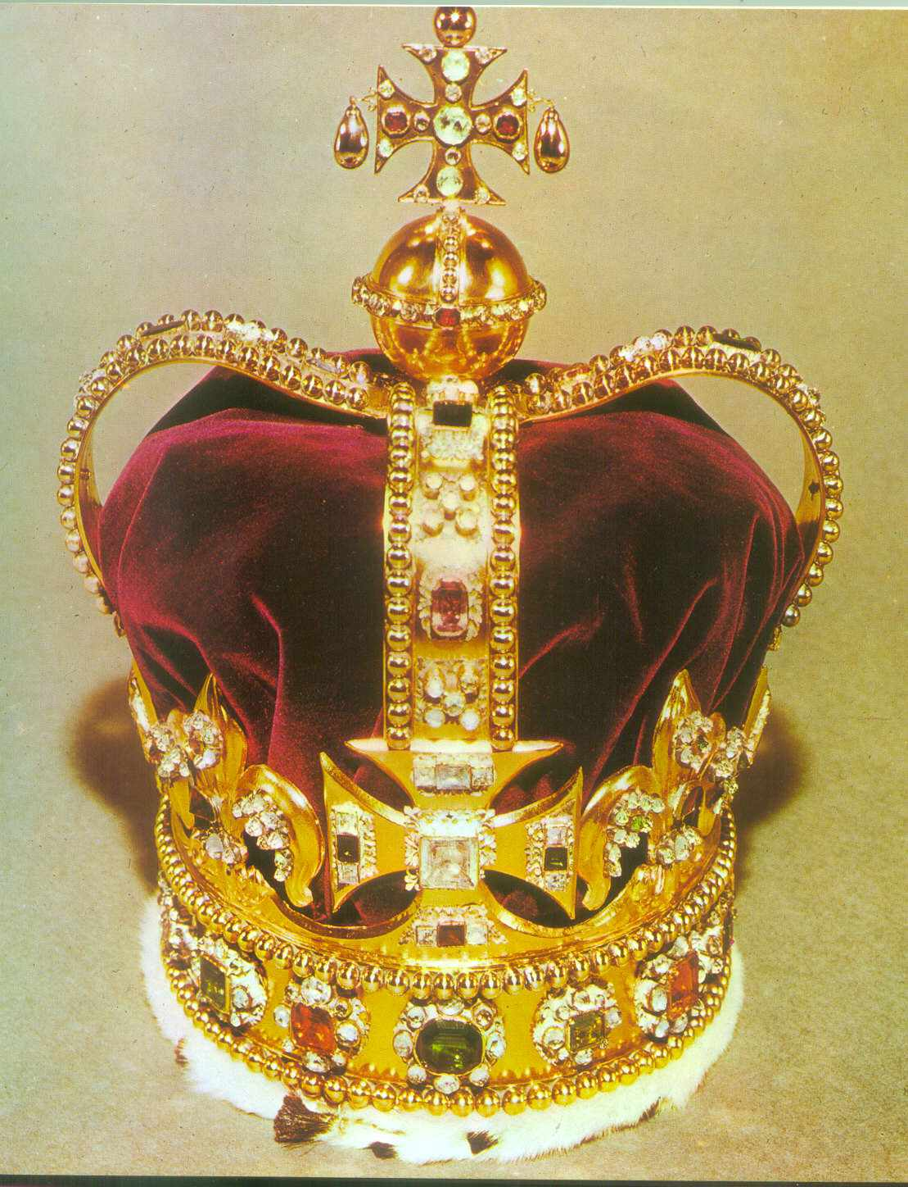
Imperial State Crown
The Tower’s greatest treasure is the Imperial State Crown.
There are 2 800 diamonds on it.

Slide 27
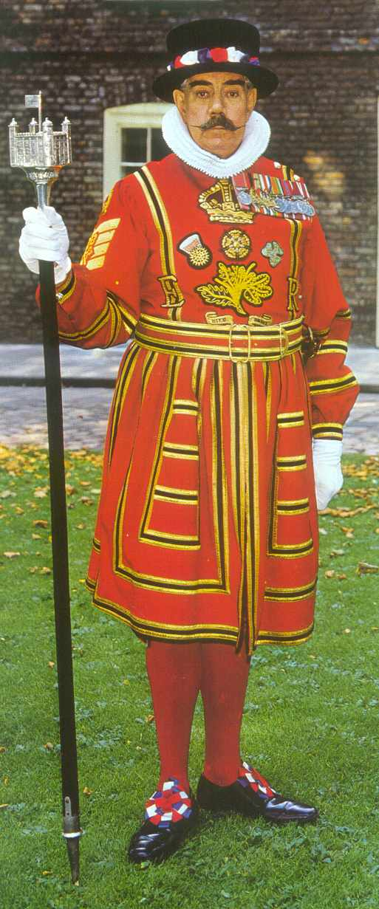
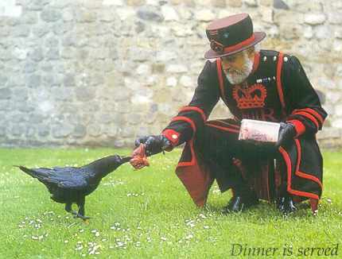
Beefeaters
The quards of the Tower are called Beefeaters.
The legend says that if the ravens leave, the Tower and the country will fall.

Slide 28
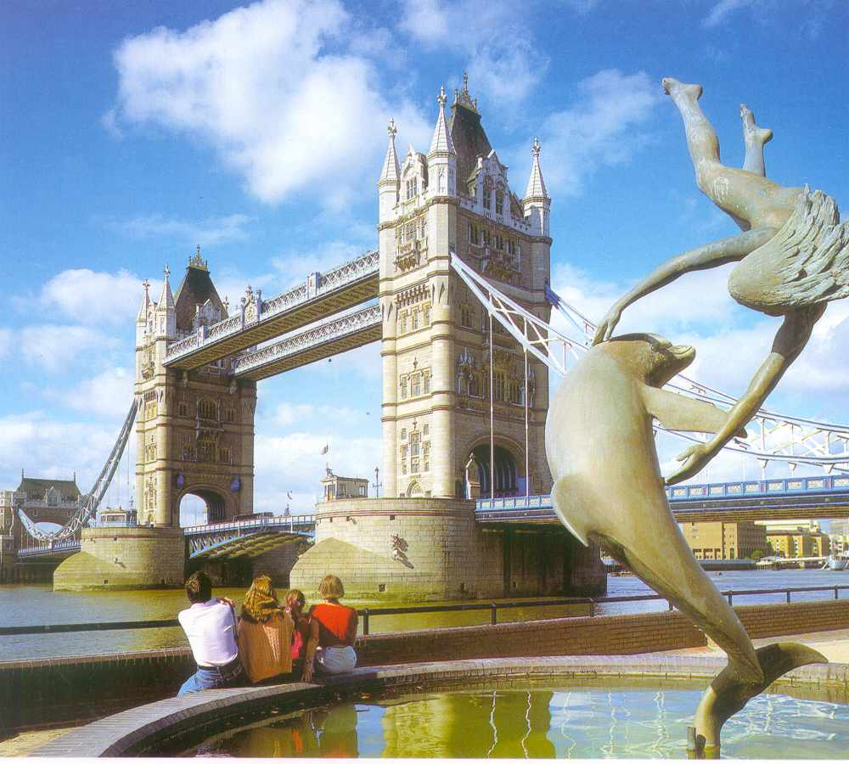
Tower Bridge
The most famous
bridge in London
is a Tower bridge.

Slide 29
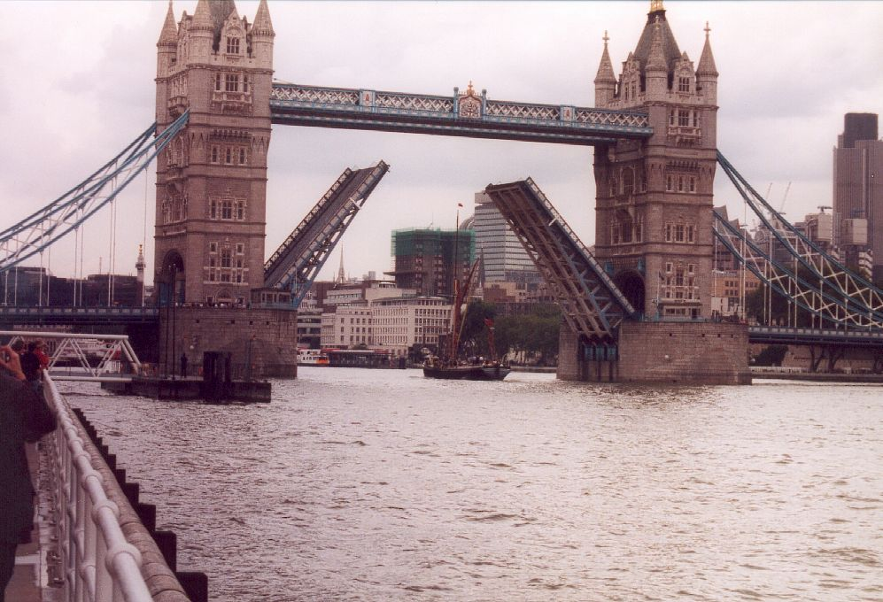
Tower Bridge
Tower Bridge is a bascule-bridge.
The bascules will open to let ships pass through.

Slide 30
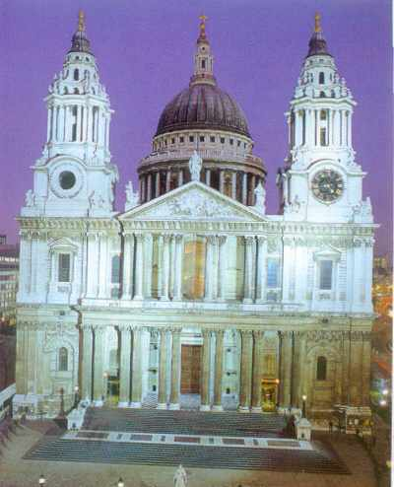
St. Paul’s Cathedral
St.Paul’s Cathedral is a famous building too.
Prince Charles and Princess Diana married here in 1981.

Slide 31
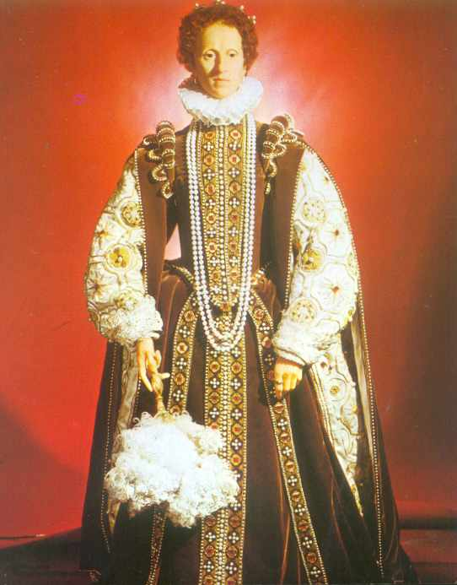
Madame Tussauds Waxmuseum
Here you can see famous people, good and bad, made of wax.
This is Queen Elizabeth I.

Slide 32
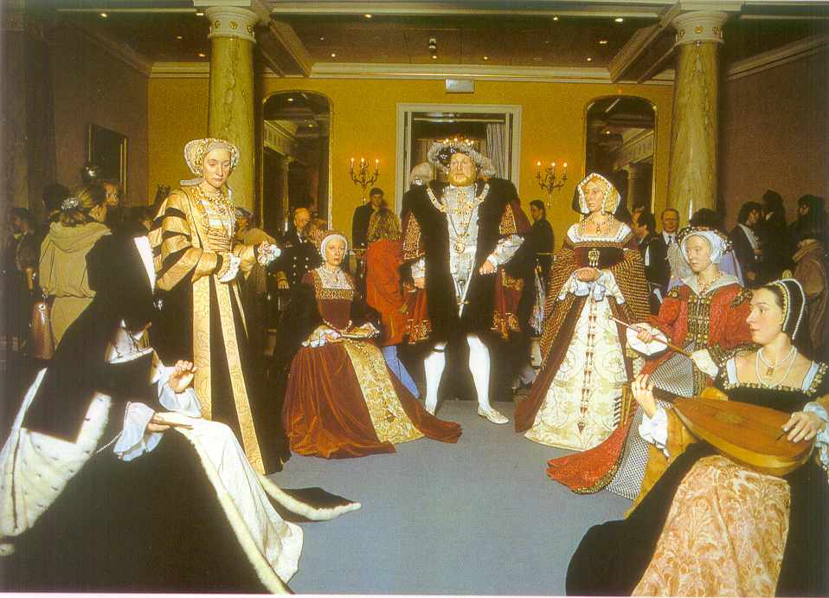
King Henry VIII with his wives

Slide 33
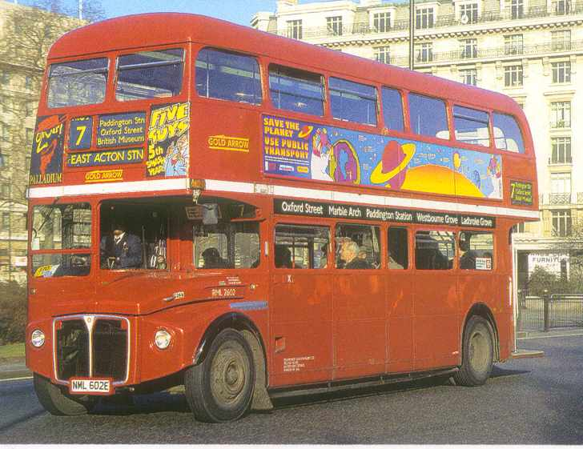
Double-deckers
There are big red buses called double-deckers in London.
People sit upstairs and downstairs on these buses.
Tourists like them very much.

Slide 34
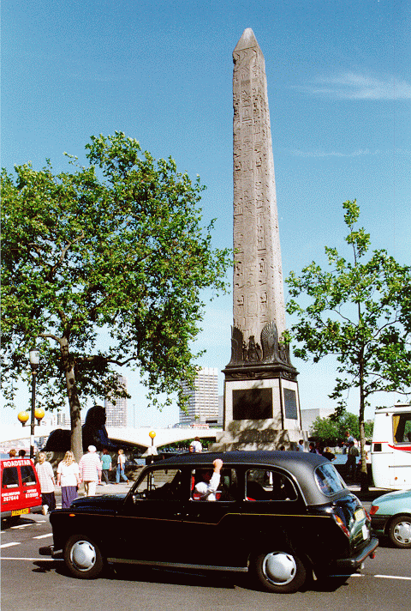
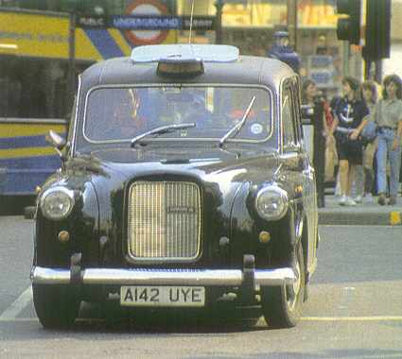
Taxis
Taxis in London are old-fashioned black cars.

Slide 35
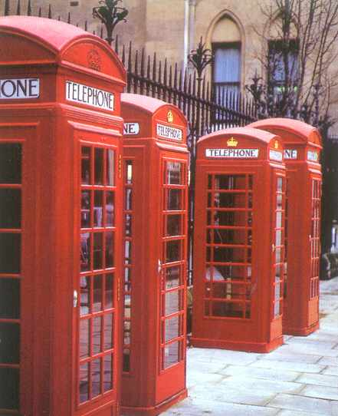
Telephone booths
From here you can call your friends.

Slide 36
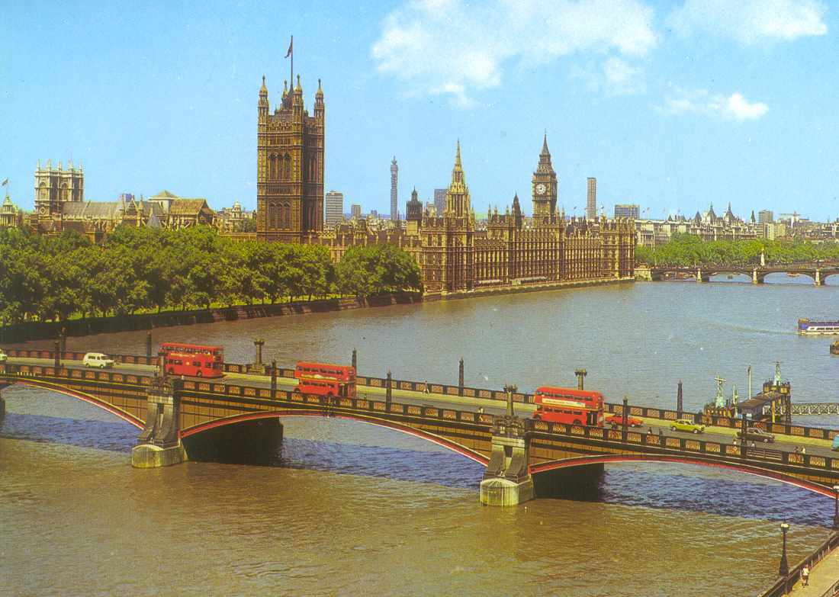
River Thames
Thames flows through London.
The River Thames is 338 km long.
It is 245 m wide here.
Even big seaships can visit London.

Slide 37
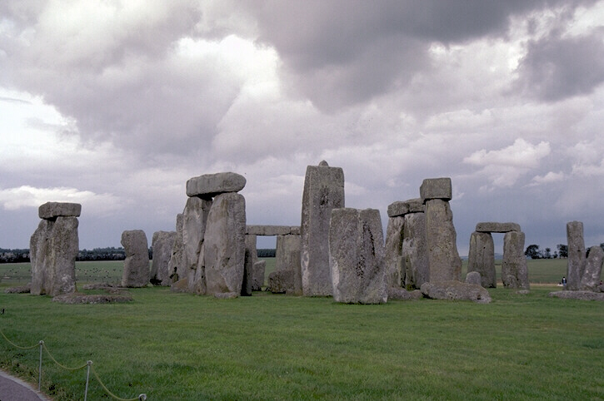
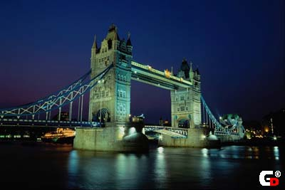

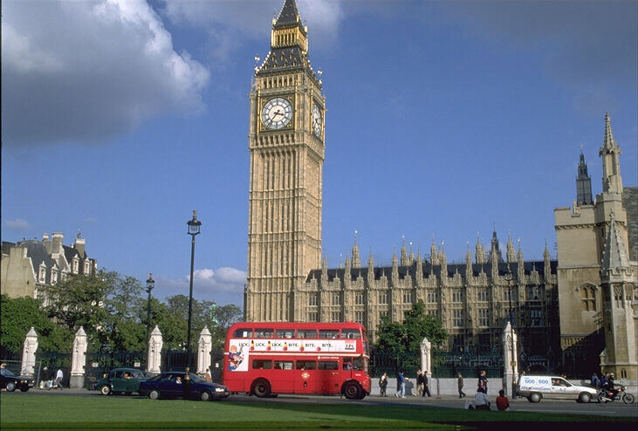
Other British symbols

Slide 38
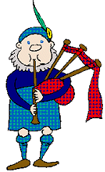
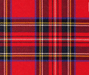
Tartan
Tartans are an internationally recognized symbol of Scotland. Highlanders wore clothes with distinctive striped or checked patterns, and the growth of clan and family tartans became popular in the mid-18th century

Slide 39
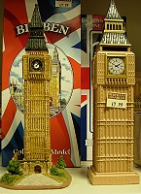
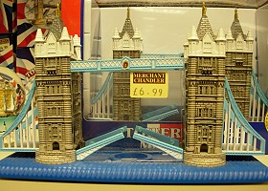
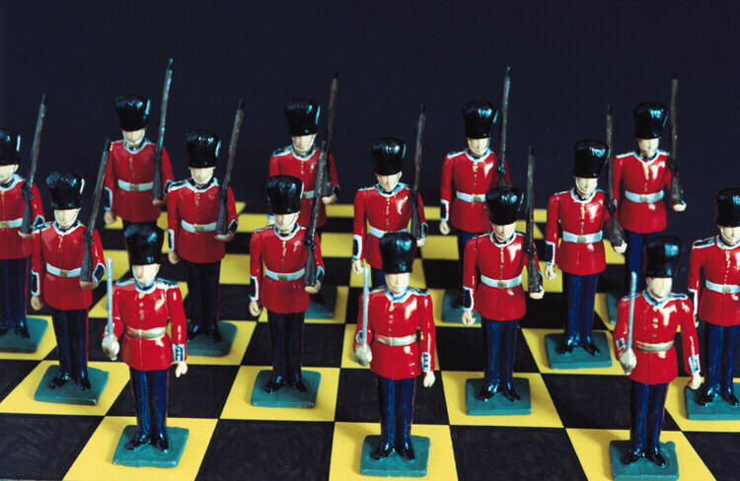
British souvenirs

